Slide 1
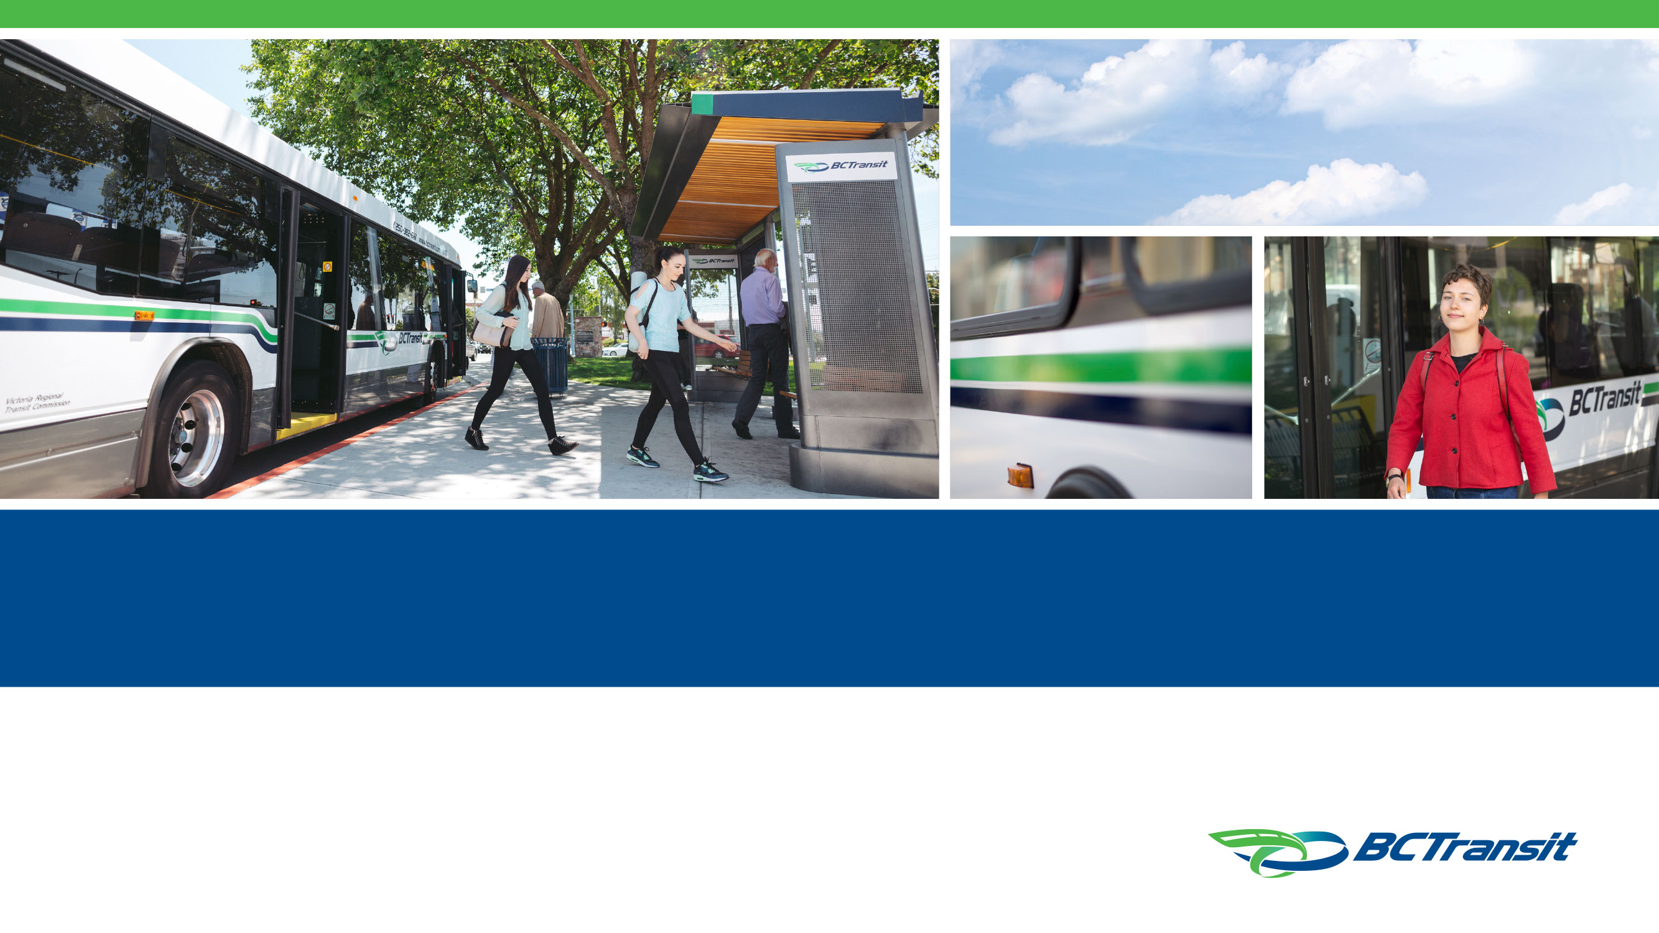
Seniors in Transit: Adapting to an Aging Population
July 2025

Slide 2
Agenda
Introduction
BC Transit Background
Evolving Needs of Senior Riders
Identifying Gaps and Opportunities
Accessible Programs & Services
Best Practices and Looking Ahead

Slide 3
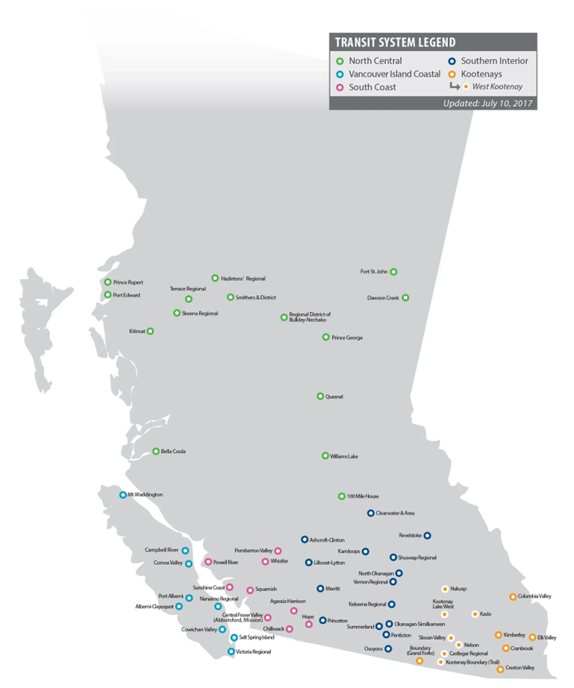
Who is BC Transit?
Provincial authority responsible for the planning, funding and operation of all transit throughout the Province outside of Metro Vancouver
58+ million passenger trips
1,100 buses in a range of sizes
1.5 million British Columbians served
130 Communities, 81 transit systems
Partnerships:
59 local government partners
18 private management companies, 5 public organizations, 14 non-profits

Slide 4
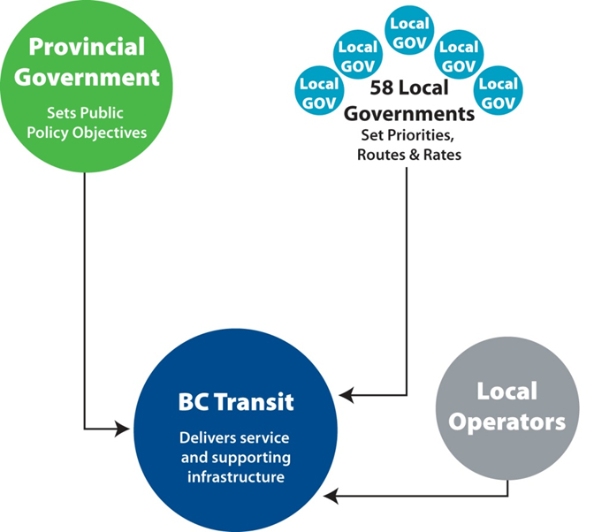
BC Transit Partnership Model
BC Transit
Allocates provincial funding
Plans transit systems to achieve local and provincial objectives
Facilitate the operation of transit systems by contract or partnership
Procures & owns fleet - Determines the fleet & facilities requirements
Marketing (Rider’s Guides) / website branding, media & public relations
Develops and manages capital budget and asset management
Provides financial & accounting services
Other professional services required to plan, finance and implement transit systems

Slide 5
BC Transit Partnership Model
Local Government
Sets local funding
Sets routes and service levels with BC Transit, ongoing review
Sets fares and manages the sale of fare products
Establishes and maintains bus stops, shelters and amenities
Carries out land use planning through Official Community Plan, Transit vision and expectations, and transit supportive policies
Determines service expansion priorities
Approves transit related agreements
Promotes ridership with BC Transit marketing/branding
Delivers transit ridership education

Slide 6
BC Transit Partnership Model
Operating Company
Delivers specified transit services as directed by BC Transit
Hires, trains and provides drivers
Manages labour relations
Collects fare revenue on behalf of the Local Government
Provides day to day customer service (info line, lost & found inquiries, etc.)
Assists with data collection
Helps promote the transit service

Slide 7
Why Seniors Matter in Transit Planning
The Demographic Imperative: By 2035, 1 in 4 British Columbians will be seniors — and many will rely on public transit.​
Designing with Dignity: Seniors face unique physical, cognitive, and emotional mobility barriers. handyDART cannot be the default answer.​
This is a Strategic Opportunity: Investing in senior-friendly transit now will deliver long-term community, economic, and mode shift benefits.

Slide 8
BC’s Aging Population
By 2035, 25% of British Columbia's population will be aged 65 and over ​

Slide 9
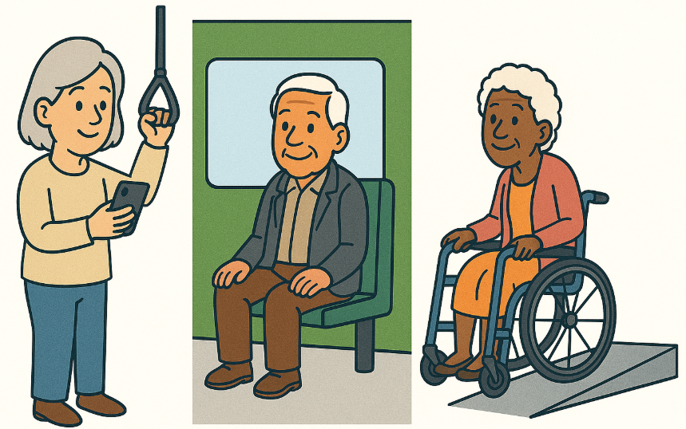
Understanding Senior’s Travel Needs
65-year-old | 3 / 4 no longer working 90% still drive
75-year-old | 19 / 20 no longer working Half driving 5% use a wheelchair
85-year-old | All retired 35% driving

Slide 10
Key Challenges
  Physical: Mobility limitations necessitating features like low-floor buses and ramps​
  Sensory: Hearing and vision impairments requiring clear audible and visual signals​
  Cognitive: Difficulties with complex transit systems and schedules
  Emotional: Anxiety related to transfers and unfamiliar technology, safety at exchanges

Slide 11



Transit Services
Conventional Transit
Fixed routes & schedules
Mainly urban settings
Custom Transit (handyDART)
Door to door
Demand responsive
For those who cannot access conventional
Links to taxi programs
Paratransit & OnDemand
Flexible routing and schedules
Light duty accessible vehicles
Small towns, rural communities, low ridership
Health Connections
Paratransit service funded by Health Authority
Provides access to medical appointments
Small towns, and rural communities

Slide 12
handyDART
handyDART is an accessible door to door, customized shared transit service. This service is provided to clients who are unable to safely and independently navigate the conventional city buses without assistance.
251
dedicated buses
29
communities
17,934
active clients

Slide 13
Is handyDART the Solution?
 | Conventional Transit | handyDART (Custom Transit)
Service Model | Fixed-route buses with scheduled stops | Pre-booked, door-to-door service
Users | General population | People with disabilities, mobility challenges, seniors unable to use regular transit
Cost per Ride | ~$4–$7 | ~$40–$75+ per ride
Subsidy Required per Ride | ~$2–$5 | ~$35–$70
Annual Rides Delivered | ~55 million | ~750,000
Booking Requirement | No booking needed – walk-on access | Pre-booking typically required
Flexibility for Users | Spontaneous travel, fixed schedule | Scheduled travel, door-to-door, limited capacity
Accessibility Features | Low-floor buses, ramps, securement areas | Full wheelchair access, personal assistance if needed

Slide 14
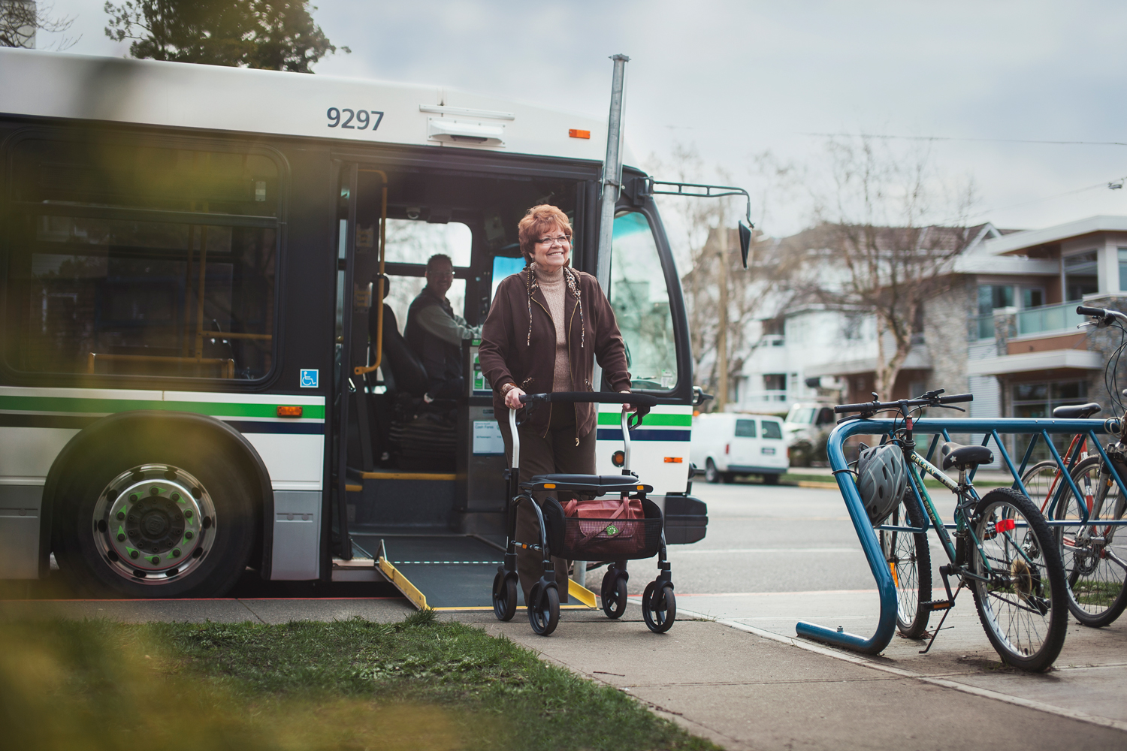
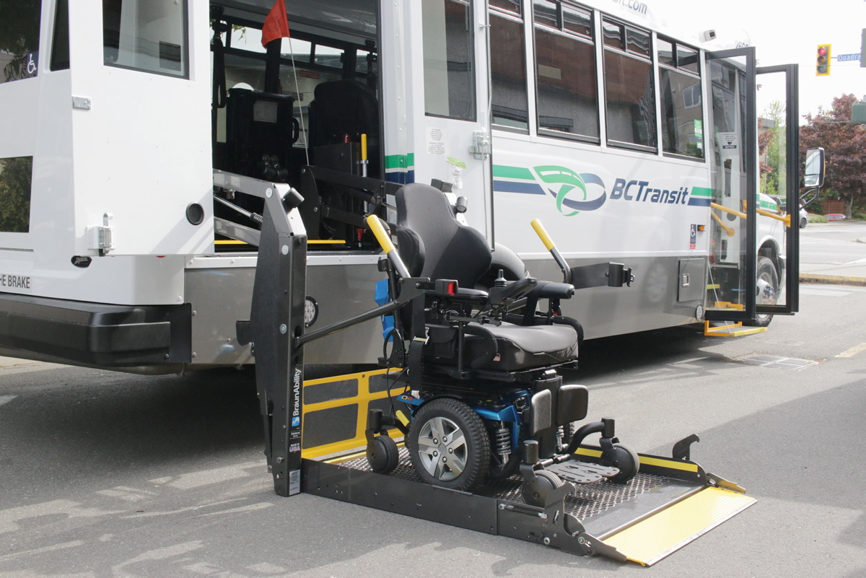
Is handyDART the Solution?

Slide 15
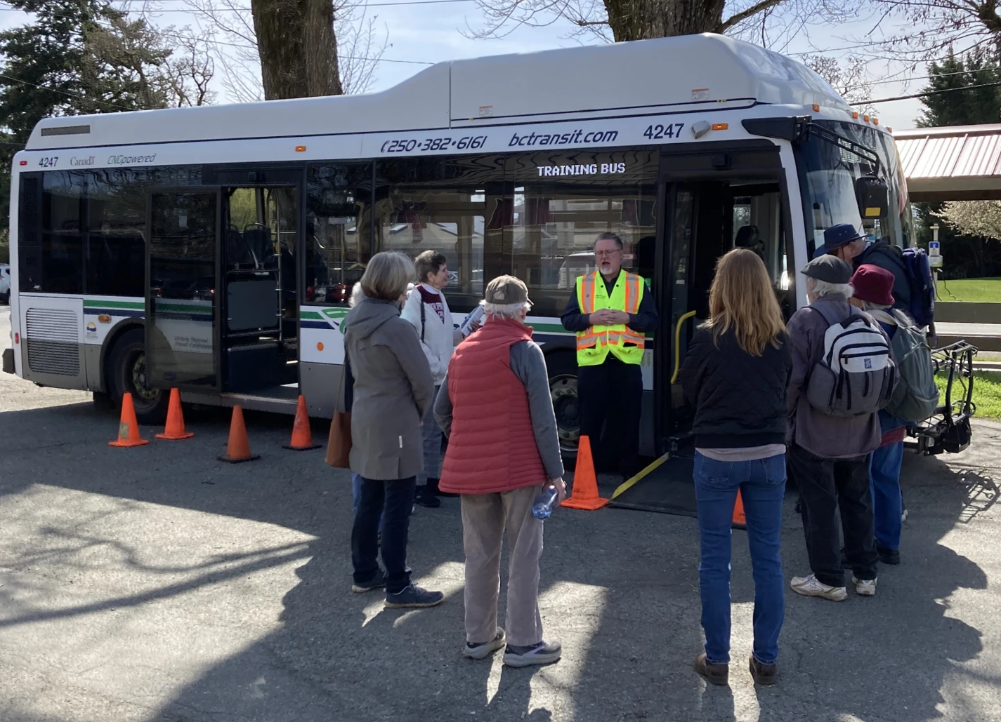
Spotlight – Travel Training Program
BC Transit programs in Victoria, Kelowna and Kamloops. Inhouse Operating Company programs in Chilliwack, Central Fraser Valley and Fort St. John.
Provides education on features of conventional and custom transit services for groups or individuals.
Customers can determine which service is most appropriate to their mobility needs.
Information on registration process for custom transit (handyDART).

Slide 16
Being Senior’s Best Transportation Solution
Safe and Accessible Travel | Operator training on assisting seniors Transit information lines and rider guides
Accessible Infrastructure and Tools | Low-floor buses, accessible stops, shelters, and curb cuts Priority seating and securement areas Real-time transit information tools to reduce uncertainty
Programs Tailored for Seniors | Travel Training handyDART Modernization Targeted Fare Programs and data sharing
Ongoing Engagement | Consultation with advisory groups Feedback loops via surveys and frontline staff

Slide 17
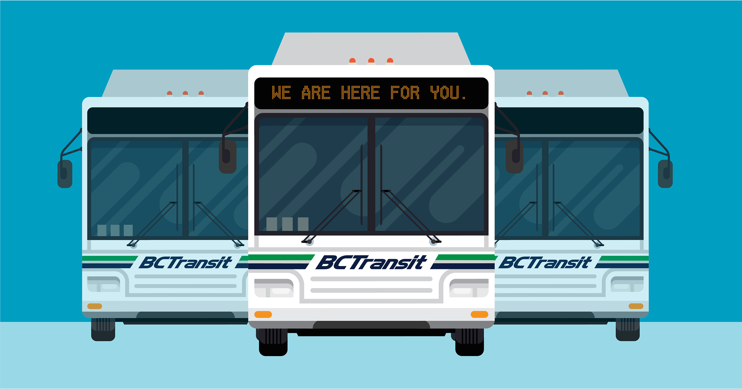
Thank you!

